Slide 1


Slide 2

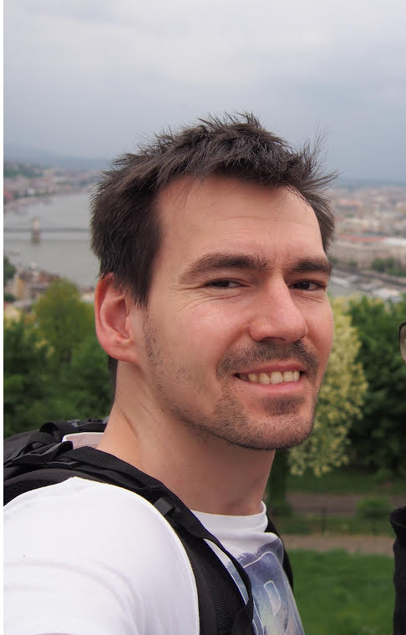

Introduction to
PowerShell DSC
Paweł Jarosz
@PaweJarosz4 | www.paweljarosz.wordpress.com

Slide 3
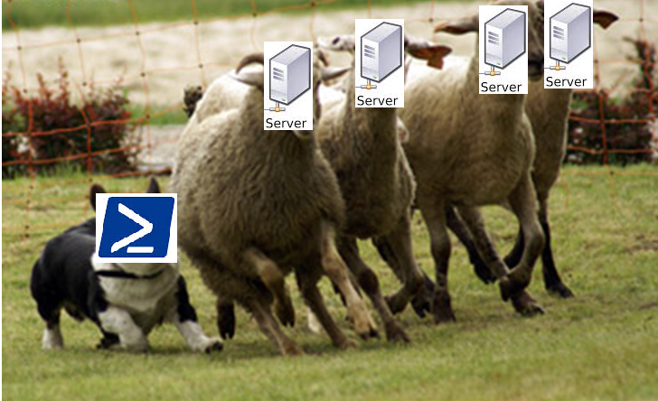
What is DSC?
Set server in desired state and keep an eye on it, so it is aligned with others

Slide 4

Origins of DSC
All started in 2002 with Monad Manifesto and
its Monad Management Models
DSC came was delivered with PoSH v4
DSC in PoSH v5 gives us features like:
Mixed mode (Push and Pull)
Partial configuration
Compliance server become Reporting server (now push clients have reports as well)
Configuration dependency (…between nodes! YEAH!)
Get-DSCConfigurationStatus
Test-DSCConfiguration (No, not Compare-DSCConfiguration)
Publish-DSCConfiguration
Update-DSCConfiguration

Slide 5
So…is DSC better than GPO or what?
Different technologies
GPO won’t actually fix drifting unless policy is updated
DSC minimize comfiguraion drift
GPO series of wishes
DSC one desired state for certain setting

Slide 6
How can I get config to my machines then?
Comes with a few flavours:
Push and Pull mode
SMB – as easyto create as easy is creating a file share
HTTP
HTTPS
„Pull server” – having Windows Servers already it is really cheap, around 0,00 USD (0,00 PLN)

Slide 7
SMB pull server
Jason Helmick recipe for SMB pull server:
Simplest to configure
Just create an SMB share
Configure clients’ LCM to read configuration from there
Then delete it and do the right thing

Slide 8
HTTP pull server? Nah.. HTTPS!
With Web Server we can secure the communication
Reporting feature
We can build nice HA solution

Slide 9
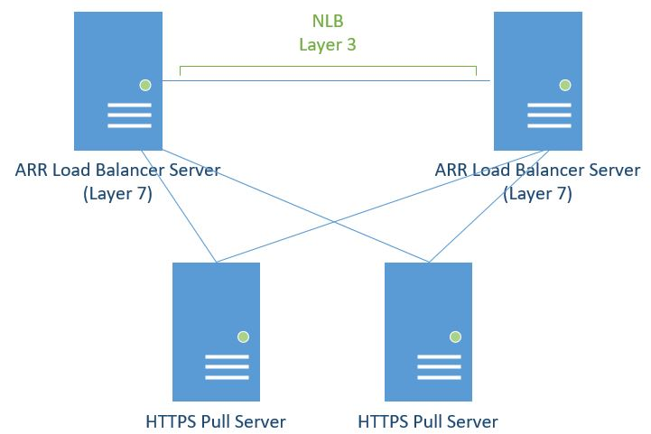
But I want to have it highly available!

Slide 10
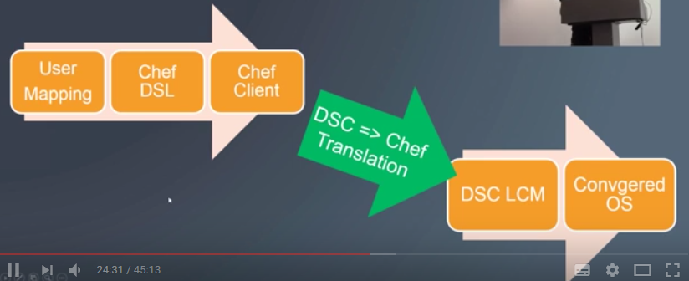
How abot DSC and Chef?
Well… DSC is cheaper ☺
Both can integrate, how:
https://www.youtube.com/watch?v=mXaAIawzNic

Slide 11
LAB DEMO
Environment:
LABDSCPS01 – W2016 / DSC HTTPS Pull Server (192.168.0.33)
LABDC01 – W2016 / DC / DSC Windows client (192.168.0.31)
LABCENTOS01 – Centos 7 / DSC Linux client (192.168.0.32)

Slide 12

Building sample Web Server on Windows
Generate the *.pfx certificate from AD CS on LABDC01
Import generated certificate to LABDSCPS01
##Step 1: Installing needed DSC module module from PowerShell gallery
Find-Module xPSDesiredStateConfiguration | Install-Module
##Step 2: DSC Pull Server Function
configuration Sample_xDscPullServer
{
(Too long, will show it directly in ISE ^^)
}

Slide 13
Building sample Web Server on Windows
###Step 3: Getting all needed variables for DSC Sample_xDscPullServer Function
$WebCertThumb = (Invoke-Command -Computername labdscps01 {Get-Childitem Cert:\LocalMachine\My | Where-Object {$_.FriendlyName -eq "DSCPSPullServerCert"} | Select-Object -ExpandProperty ThumbPrint})
$Guid = (New-Guid).Guid
##Step4: Running Sample_xDscPullServer function to create DSC Server MOF file
Sample_xDSCPullServer -certificateThumbprint $WebCertThumb -RegistrationKey $Guid -OutputPath c:\dsc\PullServer
##Step4: Fire in the hole!
Start-DscConfiguration -Path c:\dsc\PullServer -Wait -Verbose -Force

Slide 14
Simple WebServer config
Configuration webservice
{
param ($MachineName)
Node $MachineName
{
#Install the IIS Role
WindowsFeature IIS
{
Ensure = "Present"
Name = "Web-Server"
}
#Install ASP.NET 4.5
WindowsFeature ASP
{
Ensure = "Present"
Name = "web-Asp-Net45"
}
}
}
webservice -MachineName localhost

Slide 15
Simple LCM config
[DSCLocalConfigurationManager()]
configuration BaseDscClientConfig
{
Node localhost
{
Settings
{
RefreshMode = 'Pull'
RefreshFrequencyMins = 30
RebootNodeIfNeeded = $true
ConfigurationMode = "ApplyAndAutoCorrect"
}
ConfigurationRepositoryWeb PullSrv
{
… (to be shown in ISE ^^)
}
BaseDscClientConfig

Slide 16



Slide 17
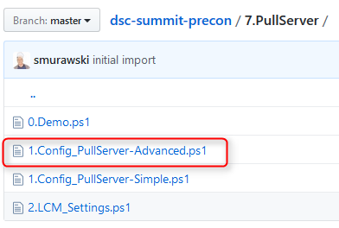
Advanced DSC pull server on server core
PowerShellOrg/dsc-summit-precon
Works on Windows Core version
Installs only these features that needed
Removes everything that is not neccessary – lowe footprint and liability

Slide 18
Sample CentOS DSC configuration
How to build simple config using nx module – create a file on a client:
configuration TestLinuxPull {
param (
[String]$ComputerName
)
Import-DscResource -ModuleName nx
node $ComputerName {
nxFile Test {
DestinationPath = '/tmp/pull'
Contents = ";Hello World!"
}
}
}
TestLinuxPull -ComputerName labcentos01 -OutputPath "c:\dsc\linux„
Rename-Item "C:\dsc\linux\labcentos01.mof" "TestLinuxPull.mof„
New-DscChecksum -Path "c:\dsc\linux" -Force

Slide 19
Sample CentOS DSC LCM (OMI) config
Simple DSC LCM config telling where pull configuration from
[DSCLocalConfigurationManager()]
configuration LinuxPull {
param (
[String]$ComputerName
)
node $ComputerName {
Settings {
RefreshMode = 'Pull'
ConfigurationMode = 'ApplyAndAutocorrect'
}
ConfigurationRepositoryWeb main {
ServerURL = 'https://labdscps01:8080/PSDSCPullServer.svc'
RegistrationKey = "875aa7df-78fa-4e71-ab1c-479d7248ab87"
ConfigurationNames = @('TestLinuxPull')
}
}
}
LinuxPull -ComputerName labcentos01

Slide 20
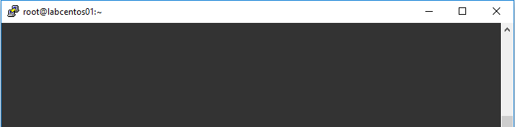
Now what?
Give LCM (OMI) some time, or apply configration manually
[root@labcentos01 ~]# firewall-cmd --permanent --zone=work --add-port=5986/tcp
success
[root@labcentos01 ~]# firewall-cmd --reload
success
[root@labcentos01 ~]# firewall-cmd --set-default-zone=work
success
$Node = "labcentos01"
$Credential = Get-Credential -UserName:"root" -Message:"Enter Password:"
#Options for a trusted SSL certificate
$opt = New-CimSessionOption -UseSsl:$true -SkipCACheck:$true -SkipCNCheck:$true -SkipRevocationCheck:$true
$Sess1=New-CimSession -Credential:$credential -ComputerName:$Node -Port:5986 -Authentication:basic -SessionOption:$opt -OperationTimeoutSec:90

Slide 21
Still now what?
Apply config directly from the client…
…or remotely from authoring station using WMI
#Manually trigger config pull on the linux client node
Set-DscLocalConfigurationManager -Path .\LinuxPull -CimSession $sess1 -Verbose
#Update configuration if there were some changes
Update-DscConfiguration -CimSession $sess1 -Wait

Slide 22
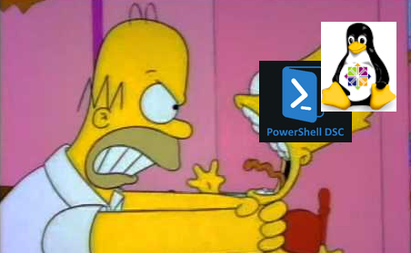
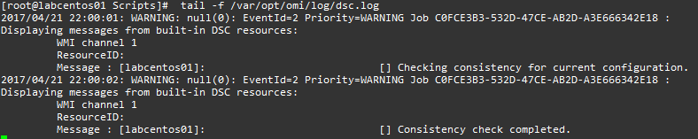
When you want to strangle…
Pay attentions to errors’ content (just kiddig, these are real nonsense)
Check logs (not kidding)

Slide 23
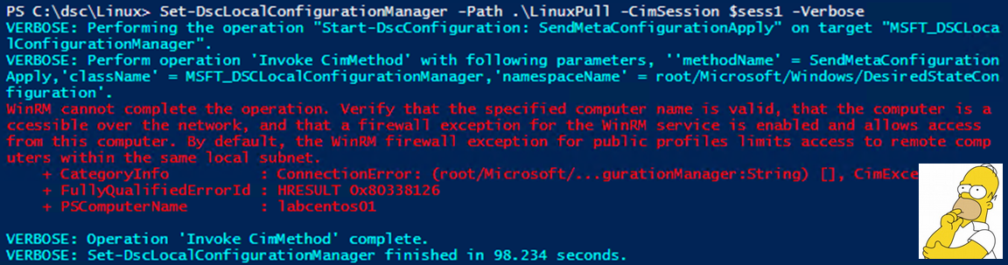
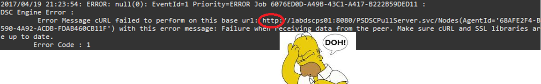
… check the logs first.
Review your work one more time (not kidding at all)

Slide 24
Inspirations
Initial idea of PowerShell and DSC written by Jeffrey Snover:
http://www.jsnover.com/Docs/MonadManifesto.pdf
Here Jeffrey tells you a little bit more about origins of PowerShell, why use DSC and how to use it with Chef:
https://www.youtube.com/watch?v=mXaAIawzNic
And here is an amazing book about DSC:
https://leanpub.com/the-dsc-book
Secured Pull Server with HA:
https://www.youtube.com/watch?v=TZbo-wIj_jw

Slide 25

Questions? I hope not…

Slide 26





pawel.jarosz@gmail.com
@PaweJarosz4
linkedin.com/in/paweljarosz2/
paweljarosz.wordpress.com
github.com/zaicnupagadi

